Slide 1
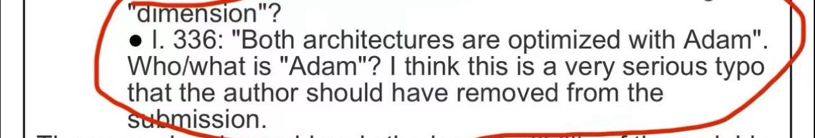
Building intuition for optimizers in deep learning
Charlie Maier · SAI-SPARKS · October 12 2026
github.com/charliemaier/opt-intro
Notes:
~1 min. Topic: what optimizers actually do, how to choose, and how to debug training by looking at figures. Format: slides for structure, the playground and notebooks for the live parts — I'll flip between them. The image is a weight matrix we'll come back to.

Slide 2
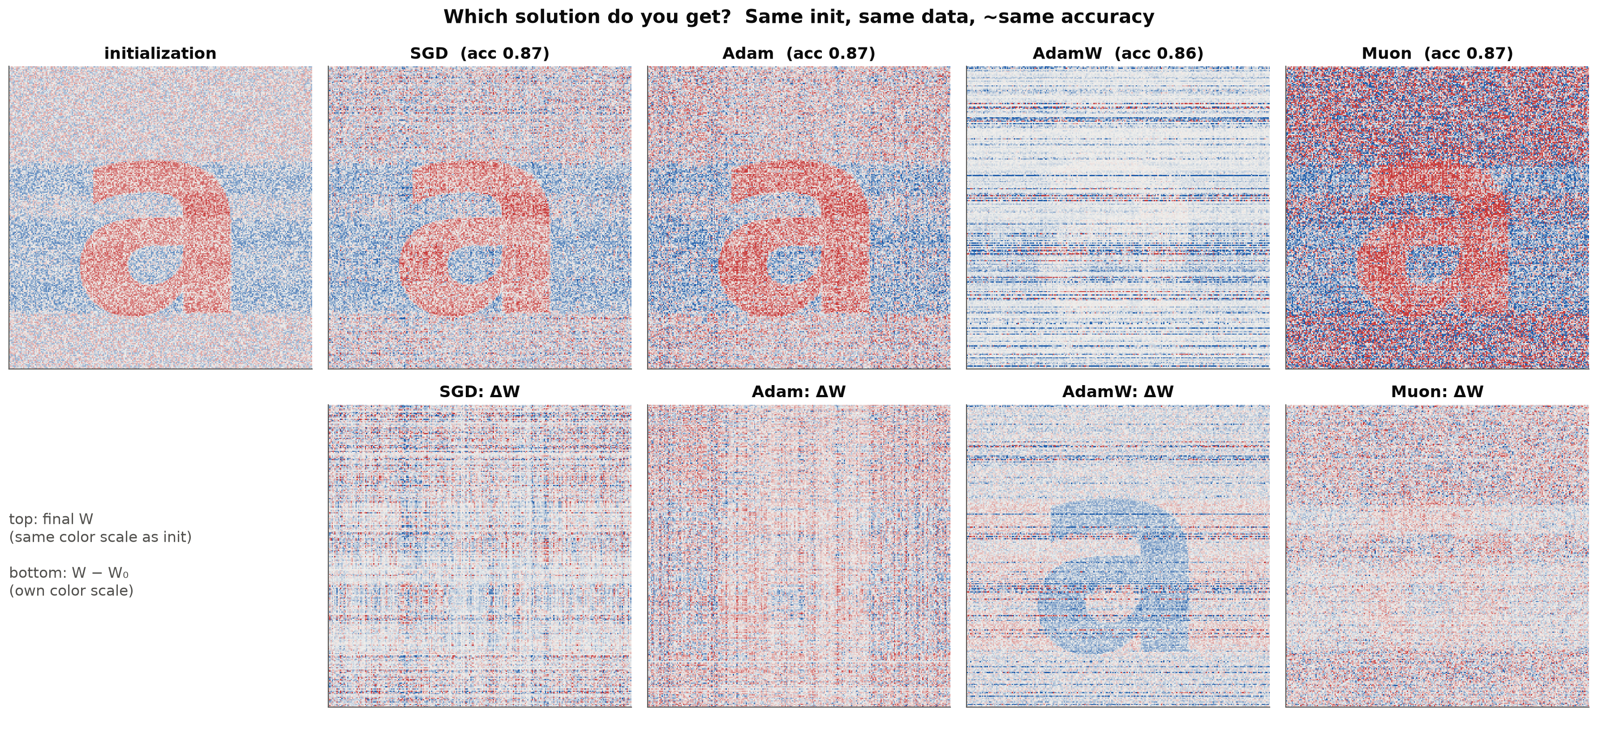
Same data, same init, same accuracy: four networks
Middle-layer weights of a small FashionMNIST classifier, initialized with a painted “a” and trained with four optimizers to ~87% accuracy. Top: final weights. Bottom: how much each weight changed.
Notes:
~2 min. Don't explain it yet — just point: SGD and Adam leave the 'a', AdamW erases it, Muon buries it under a big change. All four have the same validation accuracy. By the end you'll know why, and why it matters if you fine-tune pretrained models. Takeaway to plant: the optimizer is not just 'how fast' — it's 'which answer'.

Slide 3



Why look past the default optimizer?
Small data, big models
Defaults are optimizer-specific
Your agent writes the loop
With ~1,000 molecules and ~1M parameters, many weight settings fit the data perfectly. The optimizer picks which one: it acts like a prior.
lr = 1e-3 is an Adam number. On our solubility task, the best learning rates span five orders of magnitude across optimizers.
Code is cheap now. Your job is to ask for the right figures and recognize what healthy training looks like.
Notes:
~2 min. Audience: chem/bio/materials. Typical project: small dataset, model with far more parameters than data points, often easy to overfit. Point 3 is the framing for the whole talk: you'll increasingly delegate the code; what you can't delegate is judgment about whether training went well.

Slide 4
One update rule, four questions
W ← W − η · P( ∇L )
the step size η · the preconditioner P · the gradient ∇L
1
2
3
4
What does the optimizer see?
What does it do with it?
What solution do you get?
How should you choose?
∇L, the gradient. In a neural network it is a sum of outer products.
P and η: curvature, per-coordinate scaling, norms.
Implicit bias, and how to read training curves by eye.
Defaults, exceptions, and what to ask your agent for.
Demo: notebook 01
Demo: playground
Demo: notebooks 02, 03
Demo: decision card
Notes:
~1.5 min. Every optimizer in this talk fits this one line: take the gradient, transform it with some P, scale it by some η. Part 1 is about the gradient itself, part 2 about choices of P and η, part 3 about the consequences, part 4 the practical card. The circle in the top-right of each slide tells you which part we're in.

Slide 5
What does the optimizer see?
1
The gradient of a layer is an outer product: error at the output × input to the layer.
1
The gradient
2
The update
3
The solution
4
Choosing
Notes:
~0.5 min. Part 1: before choosing what to do with the gradient, look at what it is.

Slide 6
One example's gradient is rank one
input xᵀ
∂L/∂W = δ xᵀ
δ = ∂L/∂y
the error arriving at the layer's output
x
the input the layer saw
A batch of B examples
sums B of these, so its rank is at most B
δ
gradient δxᵀ: every row is a multiple of xᵀ, every column a multiple of δ
Notes:
~2 min. Chain rule for y = Wx. The gradient is (output error) times (input), an outer product. Look at the picture: the matrix is a 'plaid' — you can read the input pattern along every row. One example = rank 1; a minibatch is a sum of B rank-1 pieces. This structure is what Muon/Shampoo exploit later. (Notebook 01 §1 verifies autograd matches this exactly.)

Slide 7
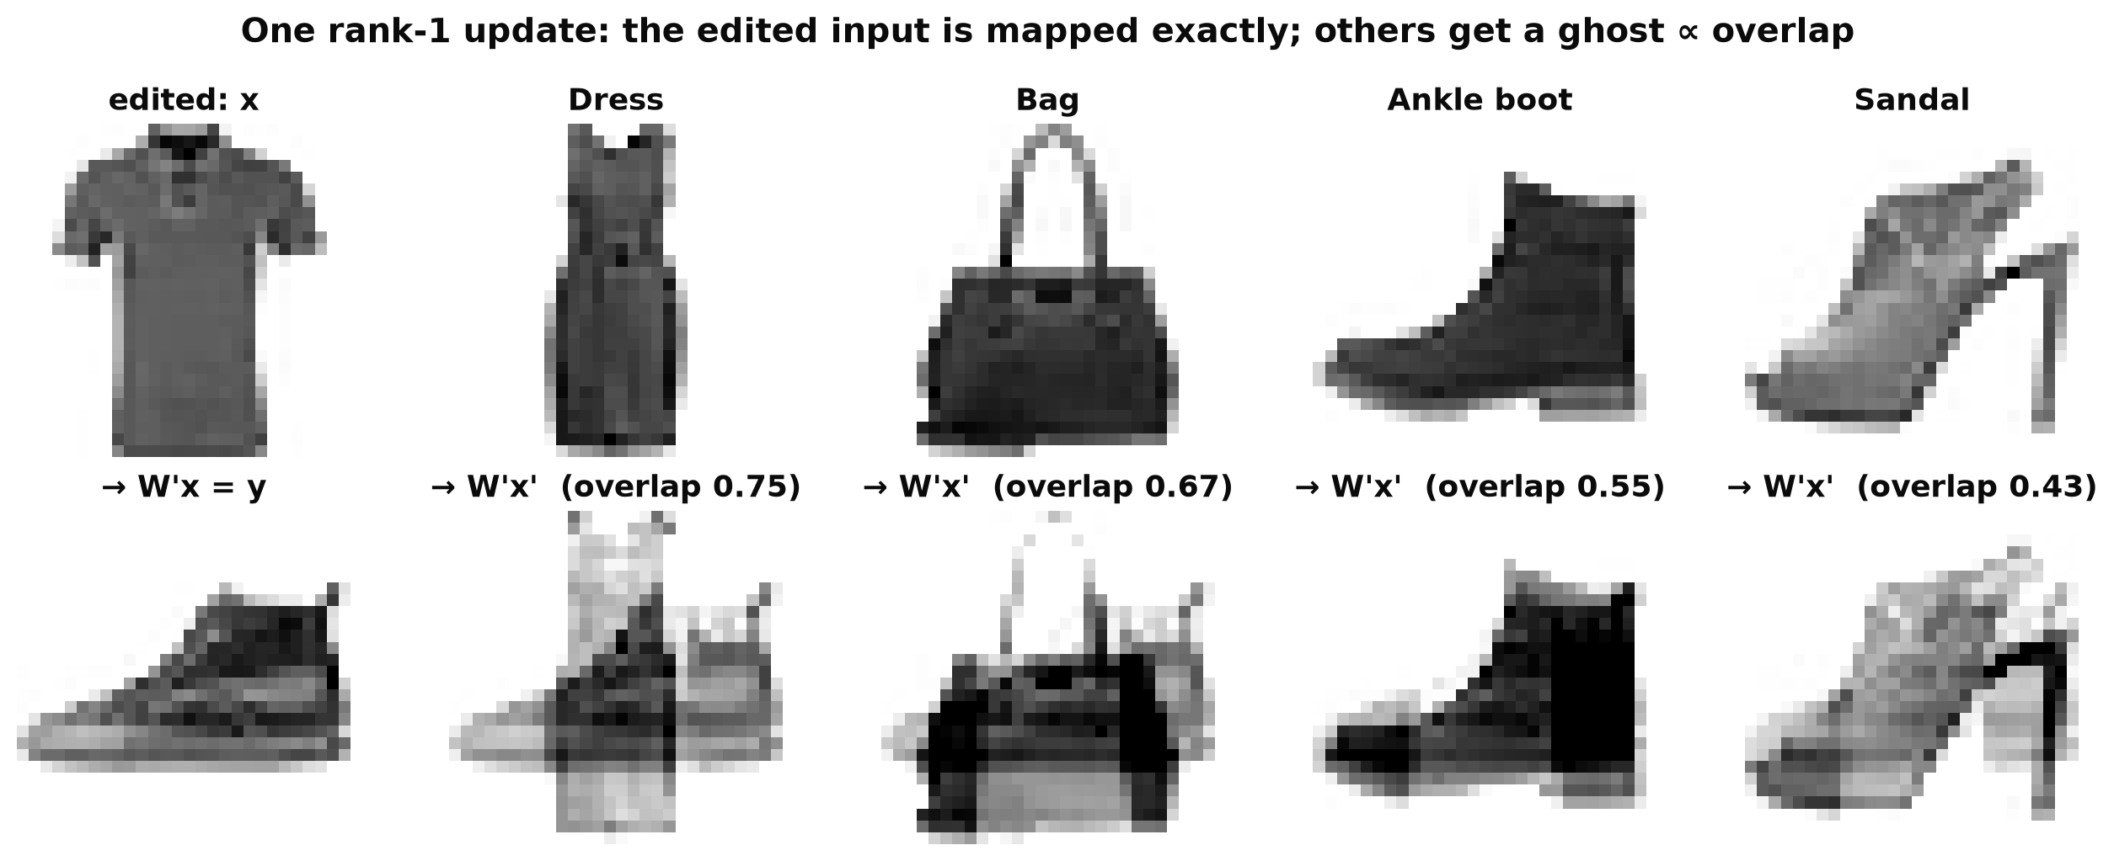
One SGD step on one example is a rank-1 edit
W′ = I + (y − x) xᵀ / ‖x‖² ⇒ W′x = y exactly
Every other input picks up a ghost of (y − x), in proportion to its overlap with x. This is how training examples interfere with each other.
Notes:
~2 min. Start from the identity map, loss ½‖Wx − y‖². One gradient step with step size 1/‖x‖² gives exactly this W′, and it maps the T-shirt to the sneaker. Now feed other images through it: the dress gets a ghost sneaker with weight 0.75 (its overlap with the T-shirt), the sandal 0.43. That's interference, the reason we use small steps and many examples.

Slide 8
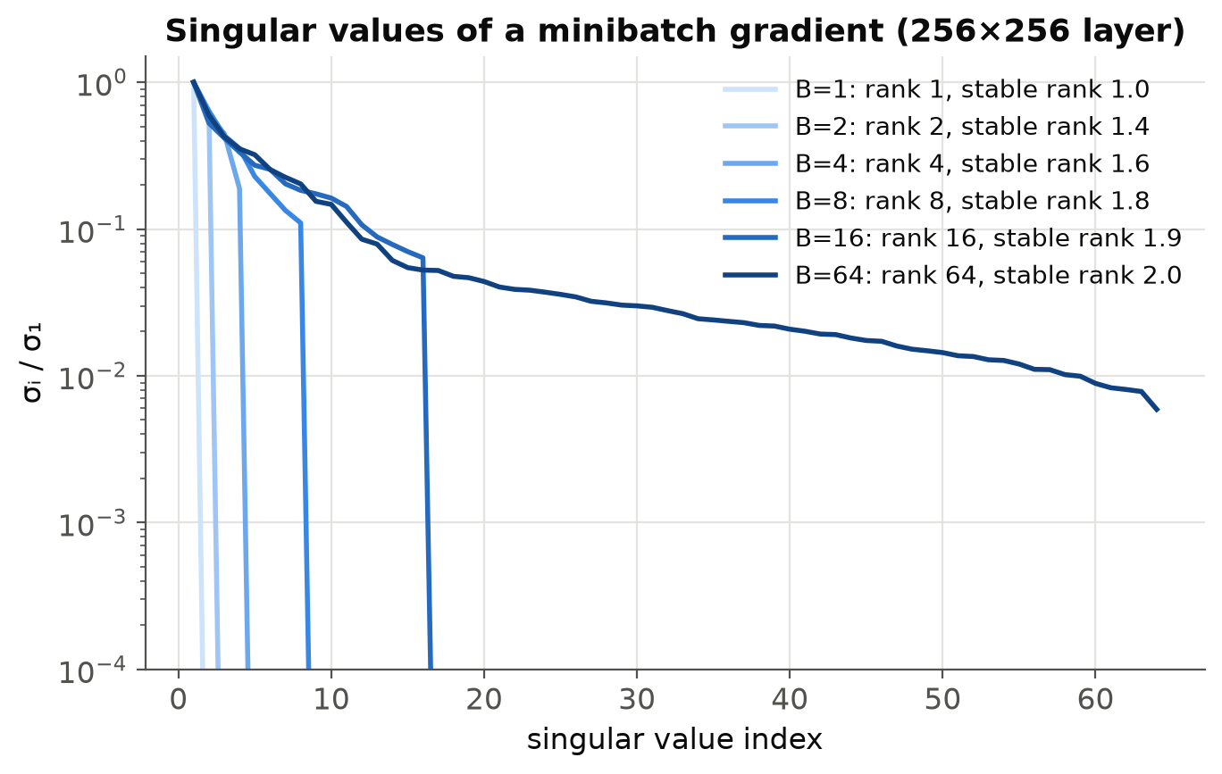
Batch gradients: rank B, but ~2 directions matter
rank = B
up to 64 nonzero singular values for a batch of 64
stable rank ≈ 2
squared Frobenius ÷ squared spectral norm: the energy sits in about two directions
Plain SGD barely updates most of the matrix. Part 2: optimizers that spread the update out.
Notes:
~1.5 min. Gradient of a 256×256 layer at initialization, for growing batch sizes. Rank grows with B, but almost all the energy is in ~2 directions (stable rank). So an SGD step is dominated by a couple of directions; the rest of the matrix hardly moves. Keep this picture in mind for the Muon slide.

Slide 9
What does it do with the gradient?
2
Every optimizer is a choice of preconditioner P and step size η.
1
The gradient
2
The update
3
The solution
4
Choosing
Notes:
~0.5 min. Part 2: the zoo of optimizers, organized by one question — how do you transform the gradient before stepping?

Slide 10
Every optimizer is a choice of P
 | Optimizer | P(g): the update direction | The idea
● | SGD | g | follow the gradient
● | SGD + momentum | running sum of past g | average out zigzags, build speed
● | Newton | H⁻¹ g | rescale by the exact curvature
 | Adagrad / RMSProp | g / √(average of g²) | per-coordinate curvature estimate
● | Adam / AdamW | m̂ / √v̂ | + momentum, noise-aware; W: decay weights separately
● | Muon | orthogonalize(momentum) = UVᵀ | equal step in every direction (spectral norm)
● | L-BFGS | H⁻¹ g estimated from recent gradients | quasi-Newton; full batch, line search
Dot colors are each optimizer's color in every figure, notebook and the playground.
Notes:
~2.5 min. The organizing table for the rest of part 2. Read down: SGD uses the raw gradient; momentum averages it over time; Newton rescales by the Hessian (perfect on a quadratic, impossible at 10^6 parameters); Adagrad/RMSProp/Adam are cheap diagonal approximations; Muon equalizes directions; L-BFGS builds a low-rank Hessian approximation from history. Colors are consistent across everything you'll see today.

Slide 11
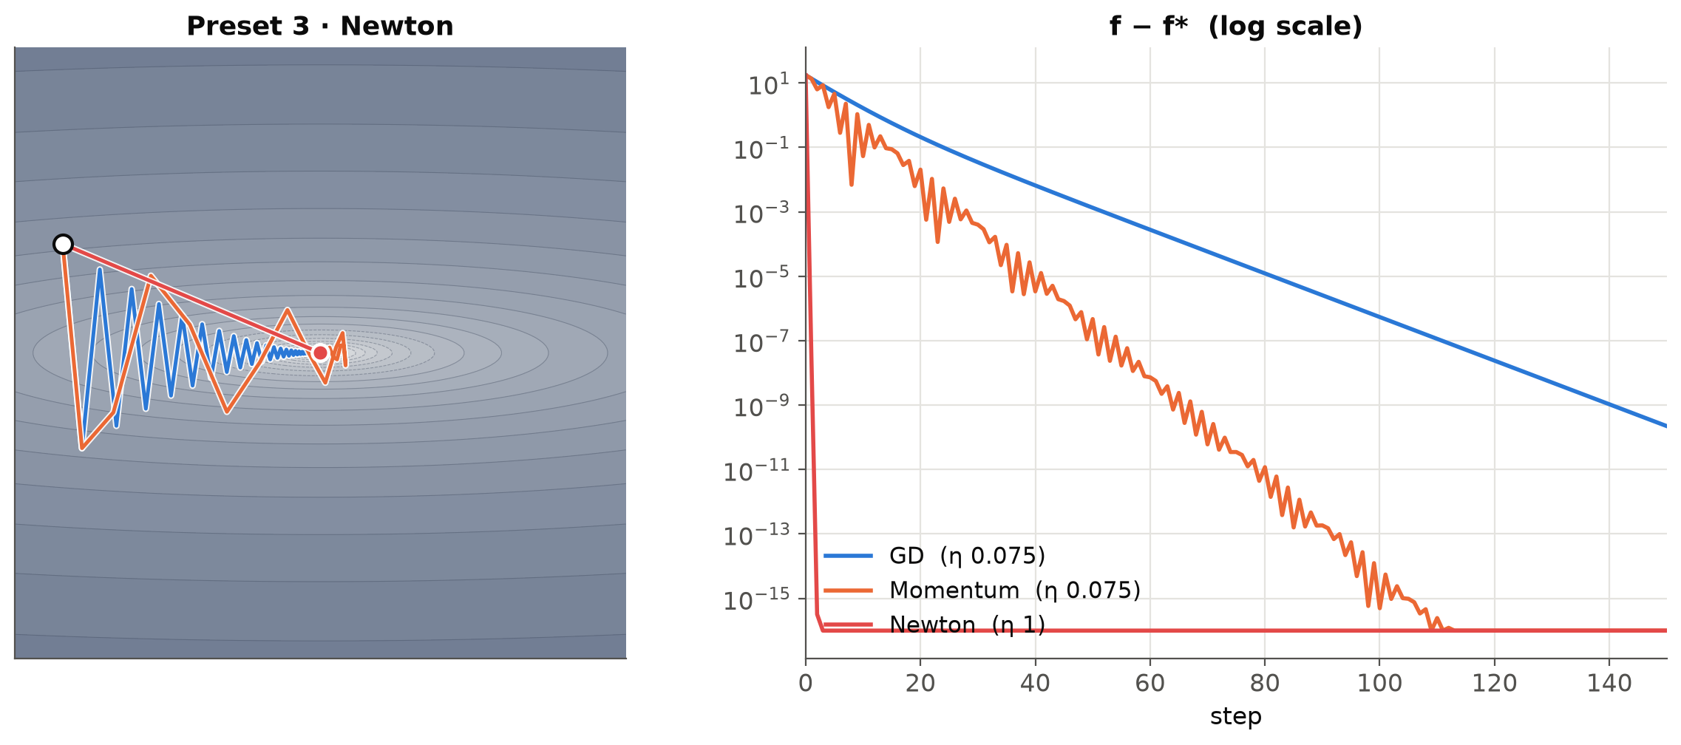
The step size is capped by the sharpest direction
Quadratic bowl with curvatures λmax ≫ λmin
Gradient descent is stable only if η < 2 / λmax
Progress along the flat direction ∝ η · λmin
≈ 2 λmin / λmax = 2 / κ per step
The condition number κ sets the speed
Momentum softens it; Newton removes it.
38 · 8 · 1
steps to reach 1e-2 at κ = 25: GD · momentum · Newton
Notes:
~2 min. The core tension of first-order optimization. The steepest direction limits how big a step you can take; the flattest direction then crawls. That ratio is the condition number. Figure: preset 3 of the playground — GD (blue) zigzags, momentum (orange) gets there in a fraction of the steps, Newton (red) jumps straight to the minimum. Then switch to the playground.

Slide 12
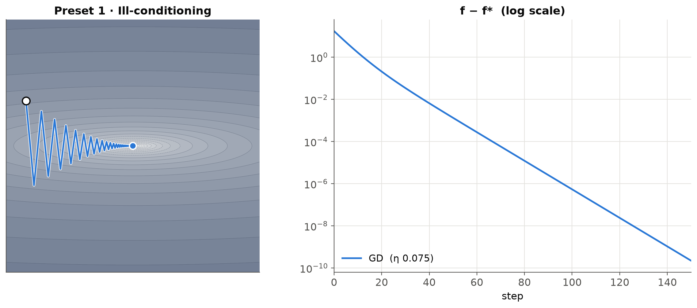
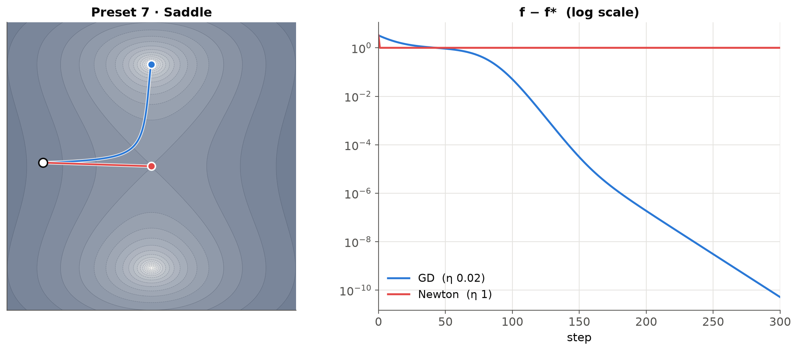
Playground: curvature, momentum, Newton
1
Ill-conditioning
GD zigzags across the steep wall and crawls along the floor.
2
Momentum
Averages out the zigzag: 8 steps to reach 1e-2 vs 38.
3
Newton
One step: it rescales by the curvature.
7
Saddle
Newton converges to the saddle point; GD rolls off it.
playground/index.html · keys 1–9 pick presets · space play/pause · r reset · click the surface to move the start
Notes:
~4 min. Switch to the browser. 1: point at the zigzag; drag GD's η slider past 0.08 to show divergence. 2: momentum. 3: Newton in one step. 7: saddle — Newton is attracted to any stationary point, which is one reason raw Newton isn't used in deep learning (lots of saddles). Backup figures are on this slide if the browser fails.

Slide 13
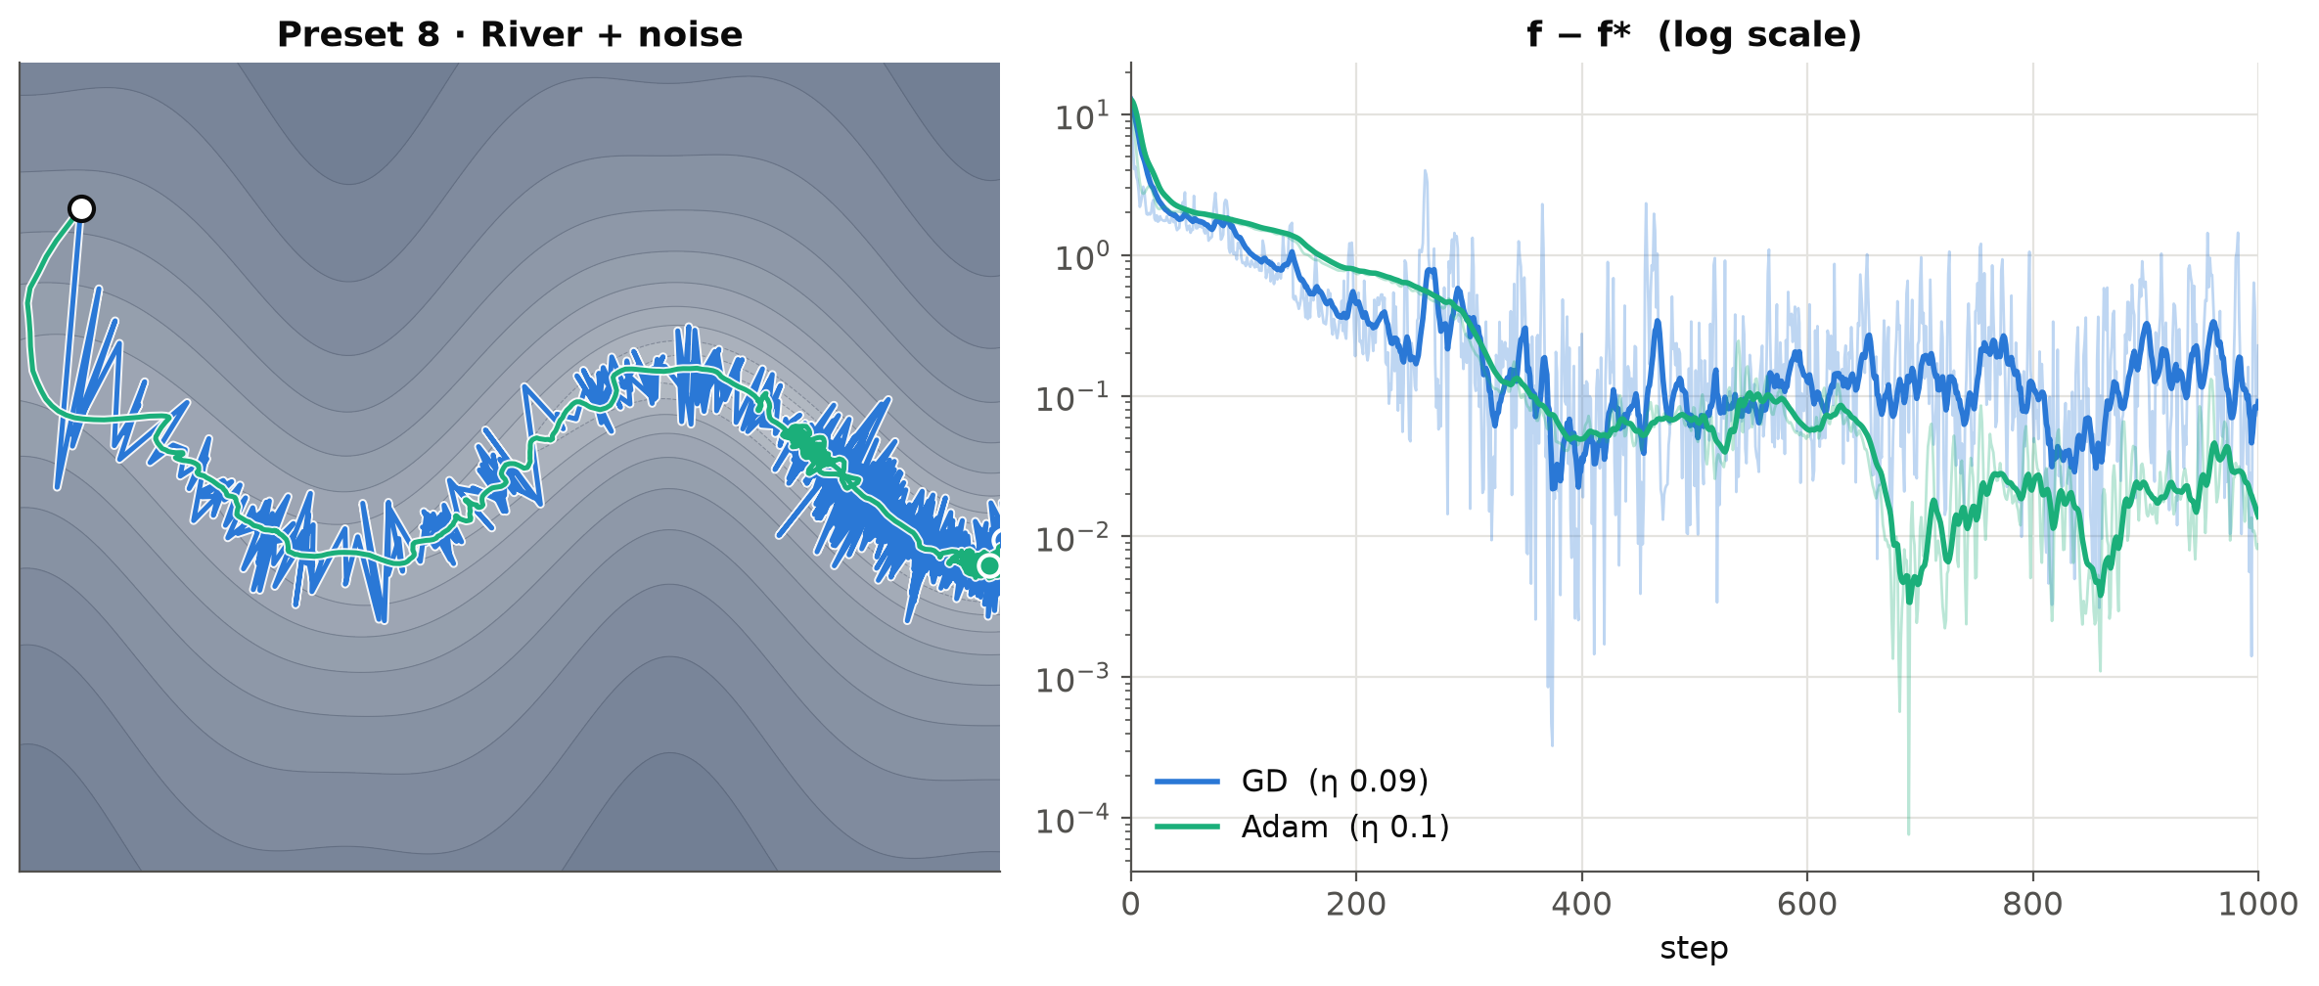
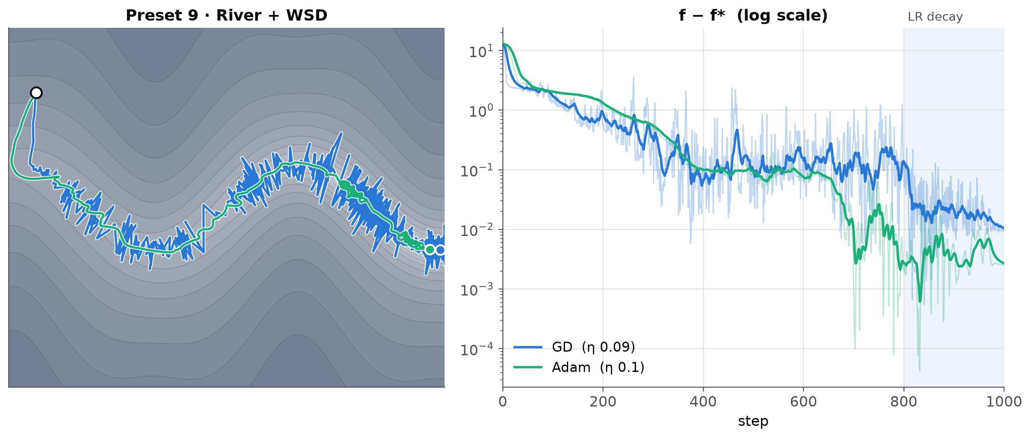
Why the loss drops when the learning rate decays
8
High, constant LR + gradient noise
Iterates bounce between the walls, so the loss looks stuck. Watch the dot: it still travels downstream.
9
Warmup–stable–decay (WSD) schedule
In the decay phase (shaded) the iterates settle onto the floor and GD's loss drops ~10×. The high LR was hiding its progress.
playground/index.html · river valley: steep walls, gently sloped floor (Wen et al. 2024)
Notes:
~3 min. The river-valley picture of LR schedules. Loss = wall height + position along the river. A large LR makes progress downstream but bounces off the walls; decaying the LR lets you drop to the floor. This is why loss curves often drop sharply at the end of a cosine/WSD schedule — and why 'the loss plateaued' at a high LR doesn't mean training stopped making progress.

Slide 14
Adagrad → RMSProp → Adam: scale each coordinate
Adagrad (2011)
v ← v + g² W ← W − η g / √v
a step size per weight, from its gradient history
RMSProp (2012)
v ← β₂ v + (1 − β₂) g²
forget old history: moving average
Adam (2015)
m ← β₁ m + (1 − β₁) g W ← W − η m̂ / √v̂
+ momentum, + bias correction for the first steps
AdamW (2019)
W ← W − η ( m̂ / √v̂ + λ W )
weight decay applied directly, not through the gradient
Diagonal preconditioning: each weight gets its own step size, but weights never "talk" to each other.
Notes:
~2 min. Each row adds one idea. Adagrad: divide by the root of the summed squared gradients — big-gradient coordinates get small steps. RMSProp: use a moving average so old history fades. Adam: add momentum and correct the bias of the averages at early steps. AdamW: decouple weight decay. The limitation in bold is the hook for the rotation demo.

Slide 15
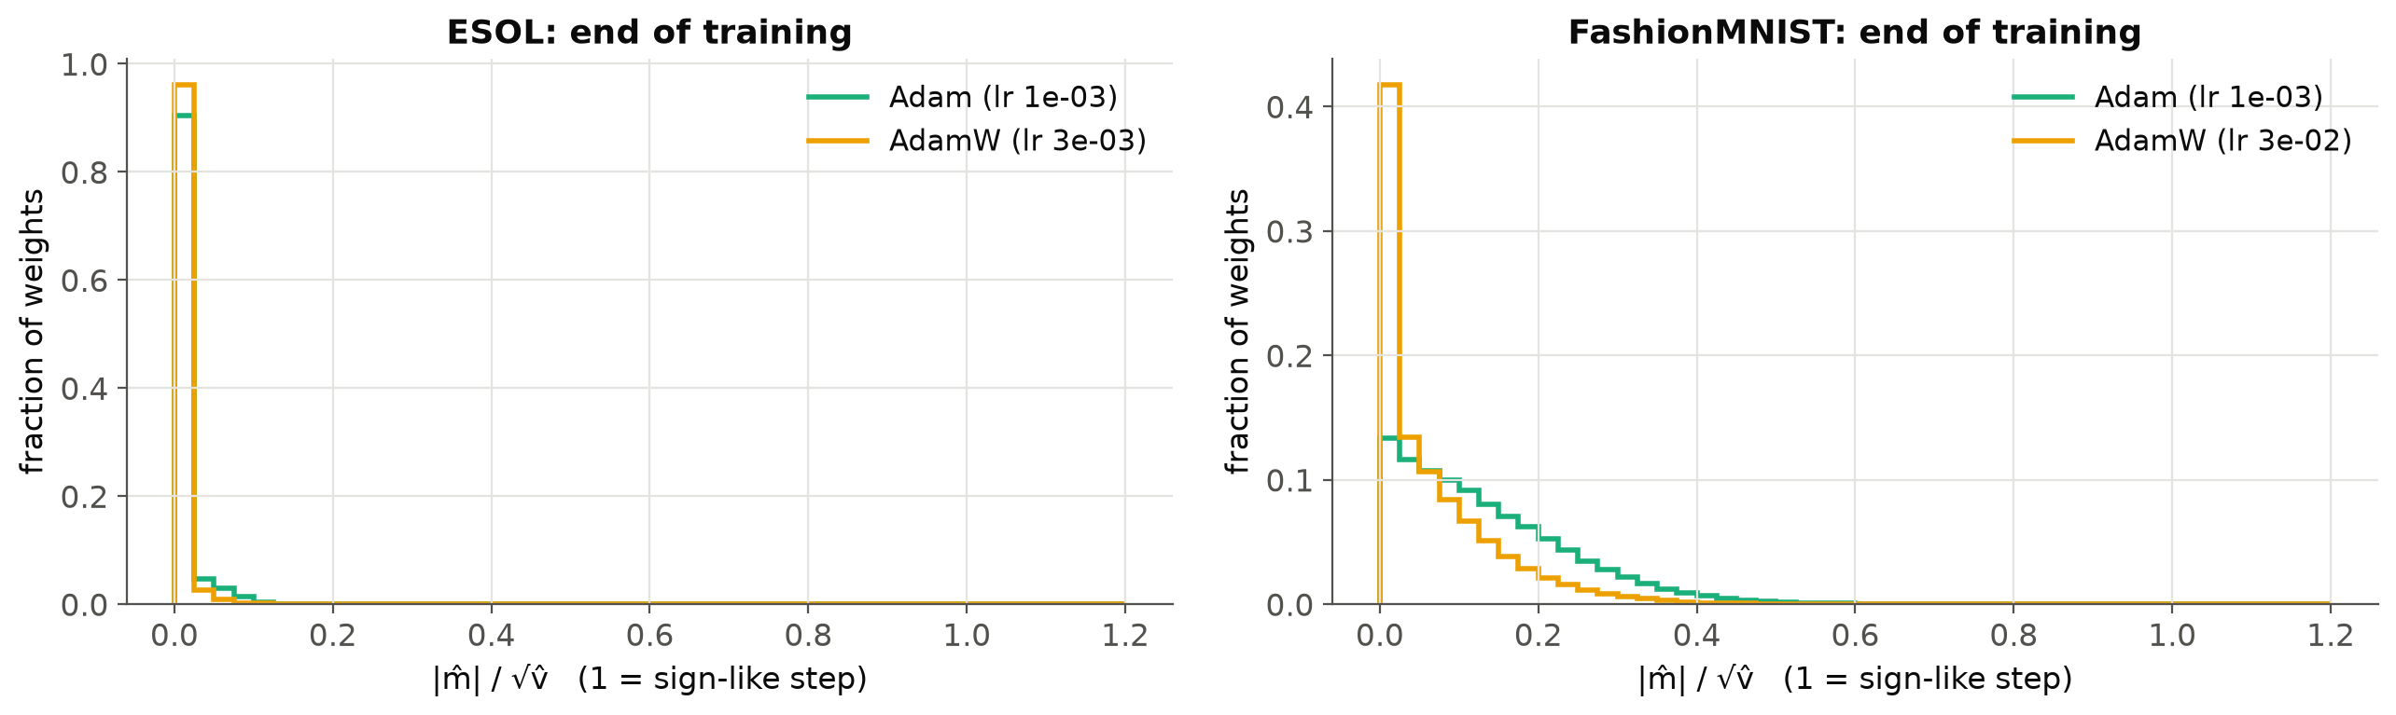
β₁ and β₂ are averaging windows
≈ 10 steps
≈ 1000 steps
m̂ / √v̂ ≈ SNR
β₁ = 0.9: m̂ estimates the mean gradient
β₂ = 0.999: v̂ estimates the gradient's typical size
consistent sign → step ≈ η (sign descent); noisy → small step
At the end of real training, almost no weight is near 1:
Adam is not acting like sign descent here.
Orvieto & Gower 2025: across 1,000+ language models, Adam beats its simplifications; β₁ = β₂ works well, and Adam reads as online estimation of the gradient's mean and variance.
Notes:
~2.5 min. The noisy-estimation view. 1/(1−β) is the effective averaging window. m̂/√v̂ is a per-weight signal-to-noise ratio: when the gradient sign is consistent, Adam moves the weight by about η — that's sign descent; when it's noise, Adam barely moves it. The histograms (ESOL, FashionMNIST, end of training) show most weights near 0. Gower and coauthors' large study: the full Adam beats the simplified variants, and setting β1 = β2 is a strong choice — consistent with this mean/variance-estimation reading.

Slide 16
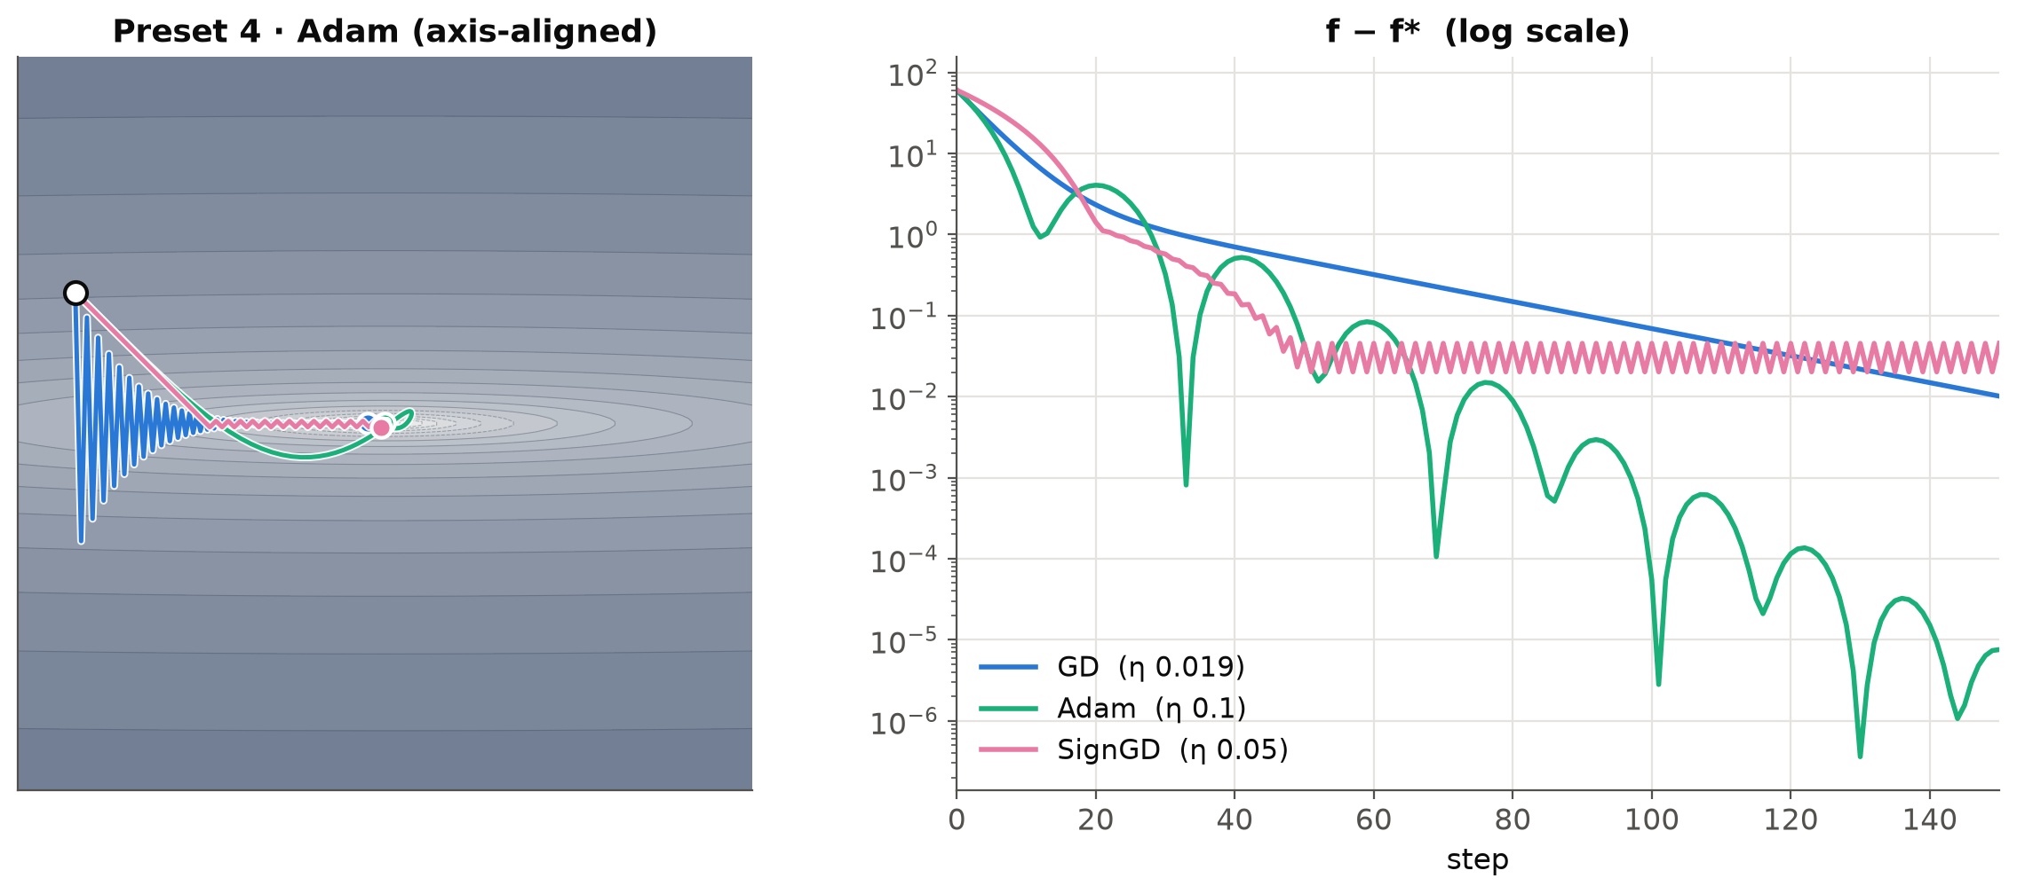
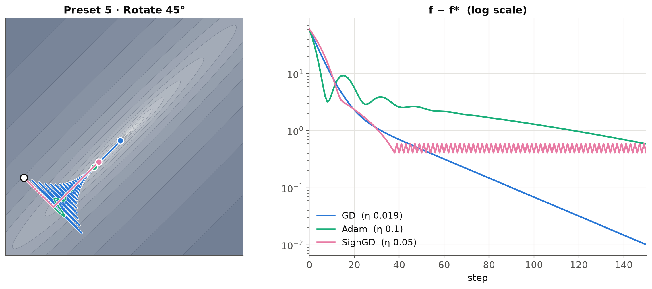
Adam vs a rotated valley
4
Axis-aligned valley
Adam converges (f − f* ≈ 8e-6); its first steps are 45° sign steps. GD crawls.
5
Same valley, rotated 45°
GD is unchanged (rotation-invariant). Adam stalls at 0.59. Per-coordinate scaling only helps when the problem lines up with the axes.
playground/index.html · same bowl (κ = 100), same start, rotated 45°
Notes:
~3 min. The key demo of part 2. Press 4, then 5. Nothing about the problem changed except the coordinate system — and Adam goes from best to worst. Diagonal preconditioning is basis-dependent. The fix is to precondition in a better basis: that's Shampoo, SOAP and Muon, next.

Slide 17
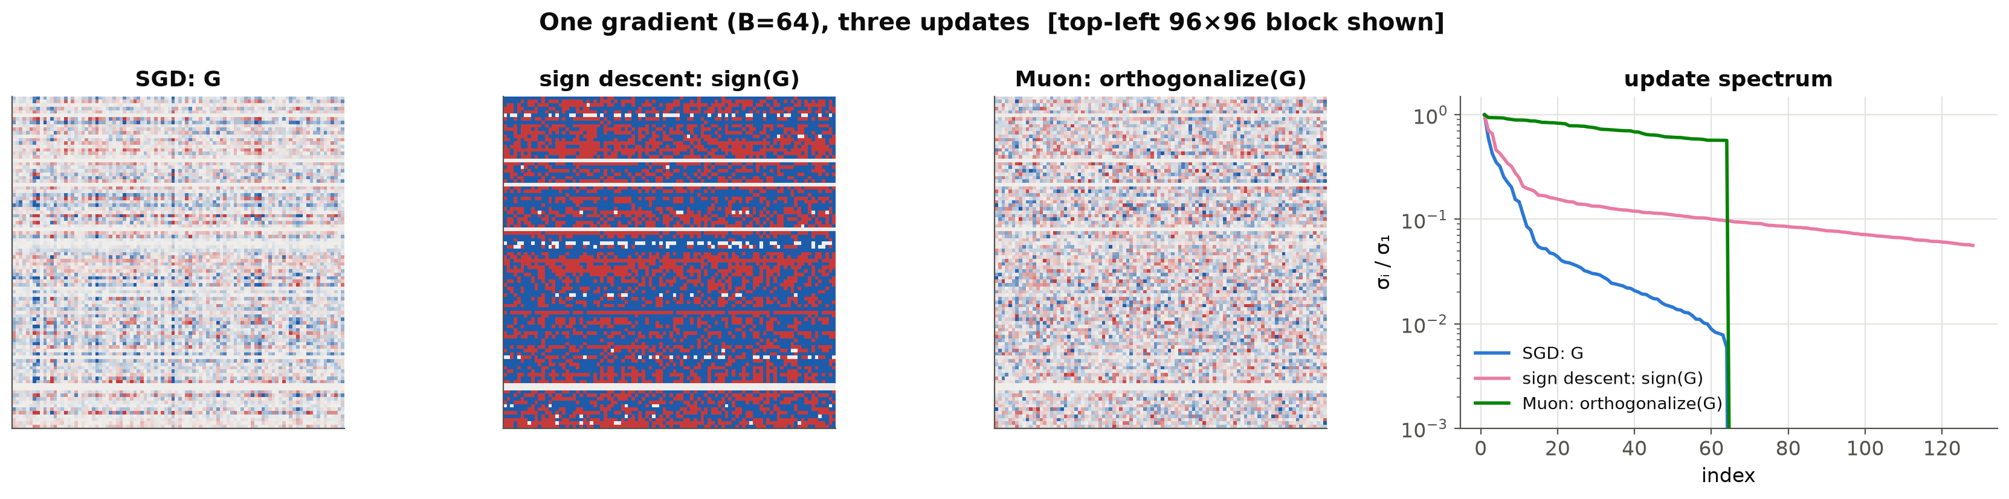
Each optimizer is steepest descent in some norm
SGD
Sign descent / Adam
Muon / Shampoo
Frobenius norm
ℓ∞ norm (max entry)
spectral norm
weights as one long vector
no single weight moves too far
no input direction changes the output too much
update: G
update: sign(G)
update: UVᵀ
Bernstein & Newhouse 2024, Old Optimizer, New Norm. Panels: one real gradient (B = 64) turned into each update, with its singular values.
Notes:
~3 min. Unifying view (Bernstein & Newhouse): if you ask 'what's the best step of a given size', the answer depends on how you measure size. Frobenius → the gradient itself (SGD). Max-entry → the sign of the gradient (Adam without its averages). Spectral norm — the right size measure for a matrix that maps inputs to outputs → UVᵀ, all singular values set to 1 (Muon). Figure: SGD's update is plaid and low-rank; sign lifts the tail; Muon's spectrum is flat — every direction the gradient touches moves equally. Ties back to slide 8.

Slide 18
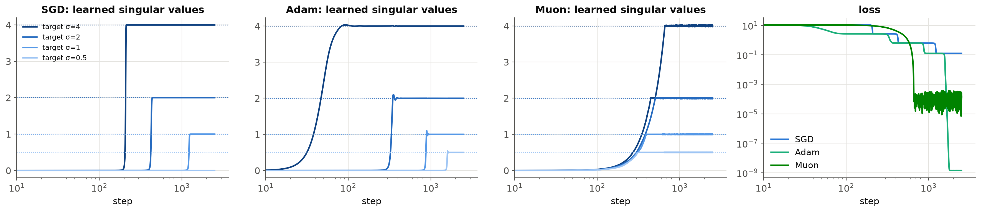
Geometry changes what gets learned first
SGD: a staircase
Adam: same order, faster
Muon: all together
Long plateaus, then sudden drops in your loss curve? This is one reason.
One singular value at a time, biggest first. Each step in the loss is a plateau, then a sudden drop.
Per-coordinate scaling compresses the plateaus but keeps the sequence.
Every direction grows at the same rate, so the small targets are reached first.
Notes:
~2 min. Deep linear network (Saxe et al. 2014) learning a matrix with singular values 4, 2, 1, 0.5 from small init. GD learns them in sequence — the classic staircase. Muon's equal-step geometry learns them simultaneously. The same final answer here, very different path; in nonlinear nets the path determines where you end up. Note Muon's noisy loss floor: fixed-size steps need LR decay to settle.

Slide 19
Beyond diagonal: Shampoo, SOAP, Muon
Shampoo
SOAP
Muon
Gupta, Koren & Singer 2018
Vyas et al. 2024
Jordan et al. 2024
Precondition a weight matrix's rows and columns separately: L^{−1/4} G R^{−1/4}. A distributed version won the external-tuning track of the AlgoPerf benchmark (2024).
Run Adam in Shampoo's eigenbasis. This fixes exactly the rotated-valley problem from demo 5.
Orthogonalize the momentum with 5 Newton–Schulz iterations (no SVD). Use on hidden matrices; embeddings, output head and biases stay on AdamW.
For small scientific models: tune AdamW or SGD first. These optimizers matter most at transformer scale, when compute is the bottleneck.
Notes:
~2 min. The 'non-diagonal' frontier, one line each. Shampoo: Kronecker-factored preconditioner — expensive but strong. SOAP: Adam in the basis that Shampoo finds — directly addresses demo 5. Muon: the spectral-norm update, cheap via Newton–Schulz; popular in speedruns and recent LLM training. Honest caveat in bold: for a 1M-parameter model on 1,000 molecules, these are rarely your bottleneck.

Slide 20
Which solution do you get?
3
With more parameters than data, many weight settings fit perfectly. The optimizer chooses among them, and a few figures tell you what happened.
1
The gradient
2
The update
3
The solution
4
Choosing
Notes:
~0.5 min. Part 3: consequences. First, which solution; then, the figures that tell you what happened in your own runs.

Slide 21
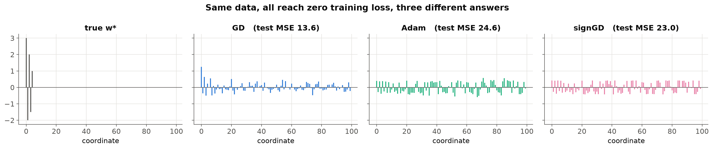
Zero training loss, 2× different test error
30 equations, 100 unknowns, sparse ground truth. Every method starts at w = 0 and reaches ~1e-13 training loss.
 | method | test MSE | ‖w‖₂ | ‖w‖∞
● | GD | 13.6 | 2.59 | 1.26
● | Adam | 24.6 | 3.36 | 0.59
● | signGD | 23.0 | 3.20 | 0.43
GD from zero stays in the row space of X, so it lands on the minimum-ℓ2 solution X⁺y.
Sign-like methods spread mass over all coordinates (small max entry).
Wilson et al. 2017; Gunasekar et al. 2018
Notes:
~2.5 min. Smallest possible example of implicit bias. Underdetermined least squares: infinitely many exact fits. All three optimizers find one; GD finds the minimum-norm one (provably), Adam and sign descent find others with flatter weights — and test error differs by ~2×, with nothing else changed. In the overparameterized, small-data regime, the optimizer (plus init and weight decay) is part of your prior.

Slide 22
Weight decay erases what the loss doesn't defend
SGD, Adam: the “a” survives. AdamW: erased; its ΔW is a negative “a”. Muon: buried under a large full-rank change (2.4× the initial norm).
Fine-tuning a pretrained model? The “a” is your pretrained knowledge.
Notes:
~2.5 min. Back to the opening figure, now explained. Each optimizer at its best LR from the sweep; all ~0.87 accuracy. SGD/Adam: the data only needed a modest change, nothing removes the 'a'. AdamW (lr 3e-2, wd 0.1): decay shrinks every weight every step; what the loss doesn't defend disappears — the bottom panel is literally −a. Muon: moves every direction equally, including ones the data barely constrains. Practical point: if you fine-tune a pretrained model, aggressive decay toward zero or large-update optimizers can quietly overwrite what you started with.

Slide 23
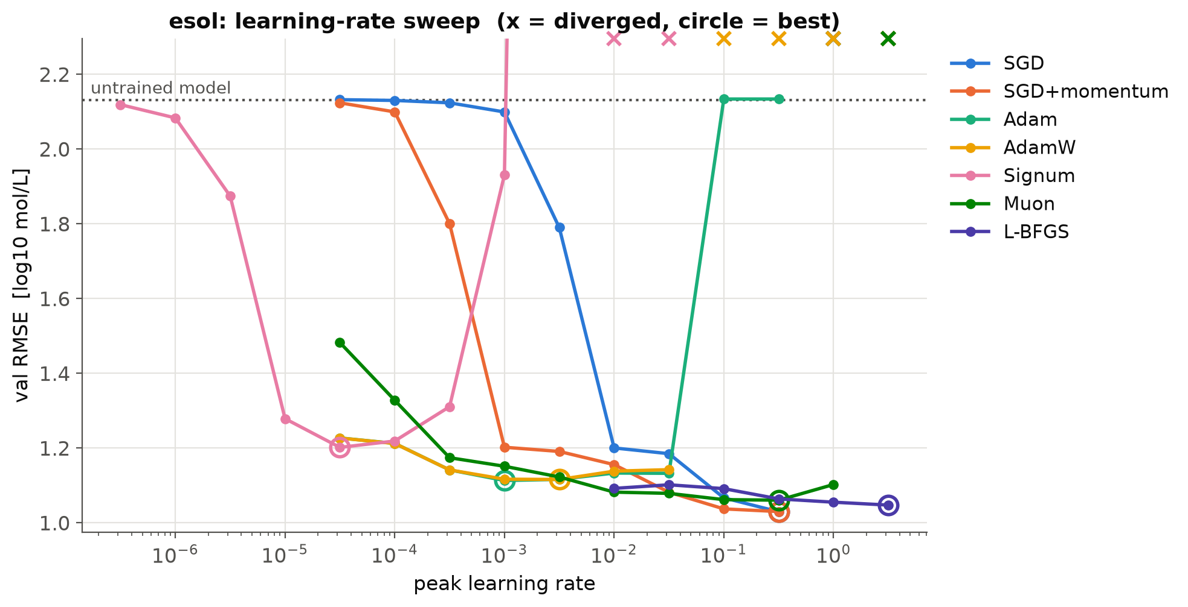
Tune the learning rate before comparing optimizers
~1.0
log units of RMSE gained by tuning the LR
~0.15
between the best and worst tuned optimizer
5 decades
spread of the best LRs (Signum 3e-5 … L-BFGS 3)
ESOL aqueous solubility: 2048-bit Morgan fingerprints → MLP (1.3M parameters, ~900 training molecules). Tuned SGD + momentum (1.03) and L-BFGS (1.05) beat Adam (1.11).
Notes:
~3 min. The first figure to ask your agent for. Each point is a full training run; one curve per optimizer. Read: (1) tuning LR matters ~6× more than which optimizer; (2) each optimizer has its own scale — 1e-3 is an Adam number; (3) bowl width = forgiveness: Adam is good over ~2.5 decades, SGD over ~half a decade with a cliff; (4) here tuned SGD+momentum and L-BFGS win — common on small, smooth problems; (5) L-BFGS is flat because its line search chooses the step. Note Adam at 0.1–0.3 lands on the dotted 'untrained' line: next slide.

Slide 24
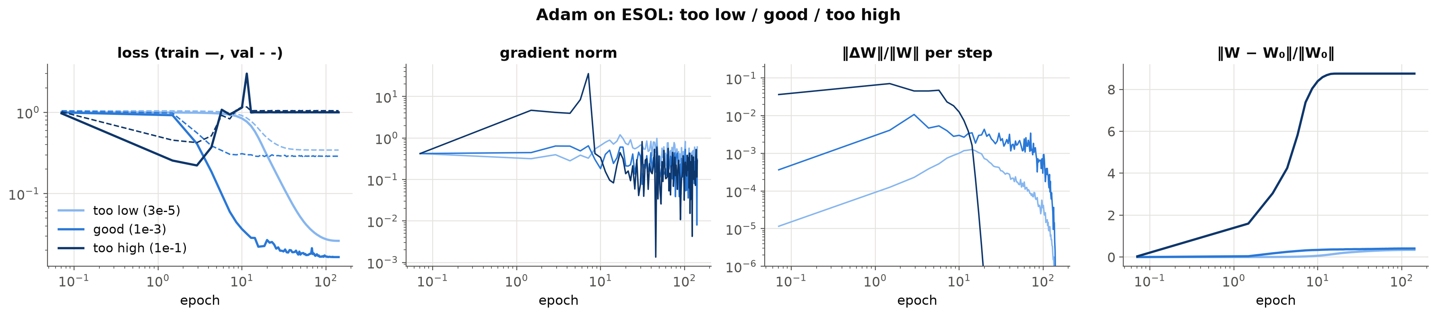
Three learning rates, three signatures
Too low (3e-5)
Good (1e-3)
Too high (1e-1)
Loss creeps and never reaches the floor. Updates tiny; weights barely leave init. → raise the LR 3–10×.
Loss reaches the data's floor. Update size ~1e-3 per step, shrinking with the schedule.
Learns, then the loss returns to the “predict the mean” level and stays. Hidden-layer updates exactly 0: dead ReLUs. No NaN, no crash. → lower the LR.
Notes:
~2.5 min. Adam on ESOL at three LRs from the sweep. Learn these shapes — they're the same in every model. The dangerous one is the silent failure: no NaN, no error, a loss curve that looks 'converged' — but it's flat at exactly the variance of the targets, i.e. the network predicts a constant. Check: a flat line at the baseline or chance level is a dead network, not slow learning. On the way, the weights were flung ~9× their initial norm.

Slide 25
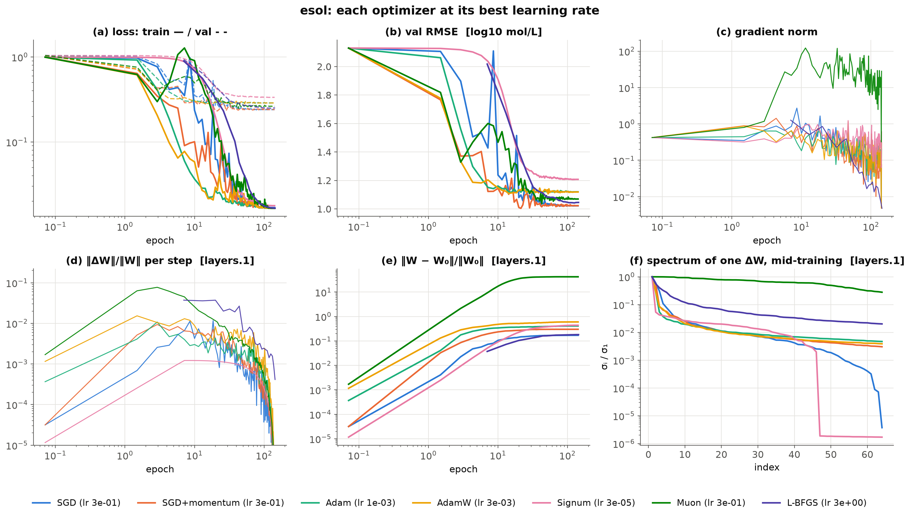
Six panels to ask your agent for
a Loss
speed, overfitting gap, spikes
b Metric
what you actually care about
c Gradient norm
noise floor, instability
d Update size
is each layer learning?
e Distance from init
which solution?
f Update spectrum
the optimizer's geometry
Notes:
~3 min. Each optimizer at its best LR on ESOL. Walk the panels: (a) everyone hits the same train-loss floor 0.0165 — that's exactly the irreducible error from 902 molecules sharing 861 fingerprints: a data limit, not an optimizer limit; (d) healthy update size ~1e-3 per step; (e) Muon moves weights tens of times their initial norm, SGD barely; (f) SGD's update spectrum falls off steeply, Muon's is flat. These are all logged by optlab/train.py; AGENTS.md tells an agent how to add them to any model.

Slide 26
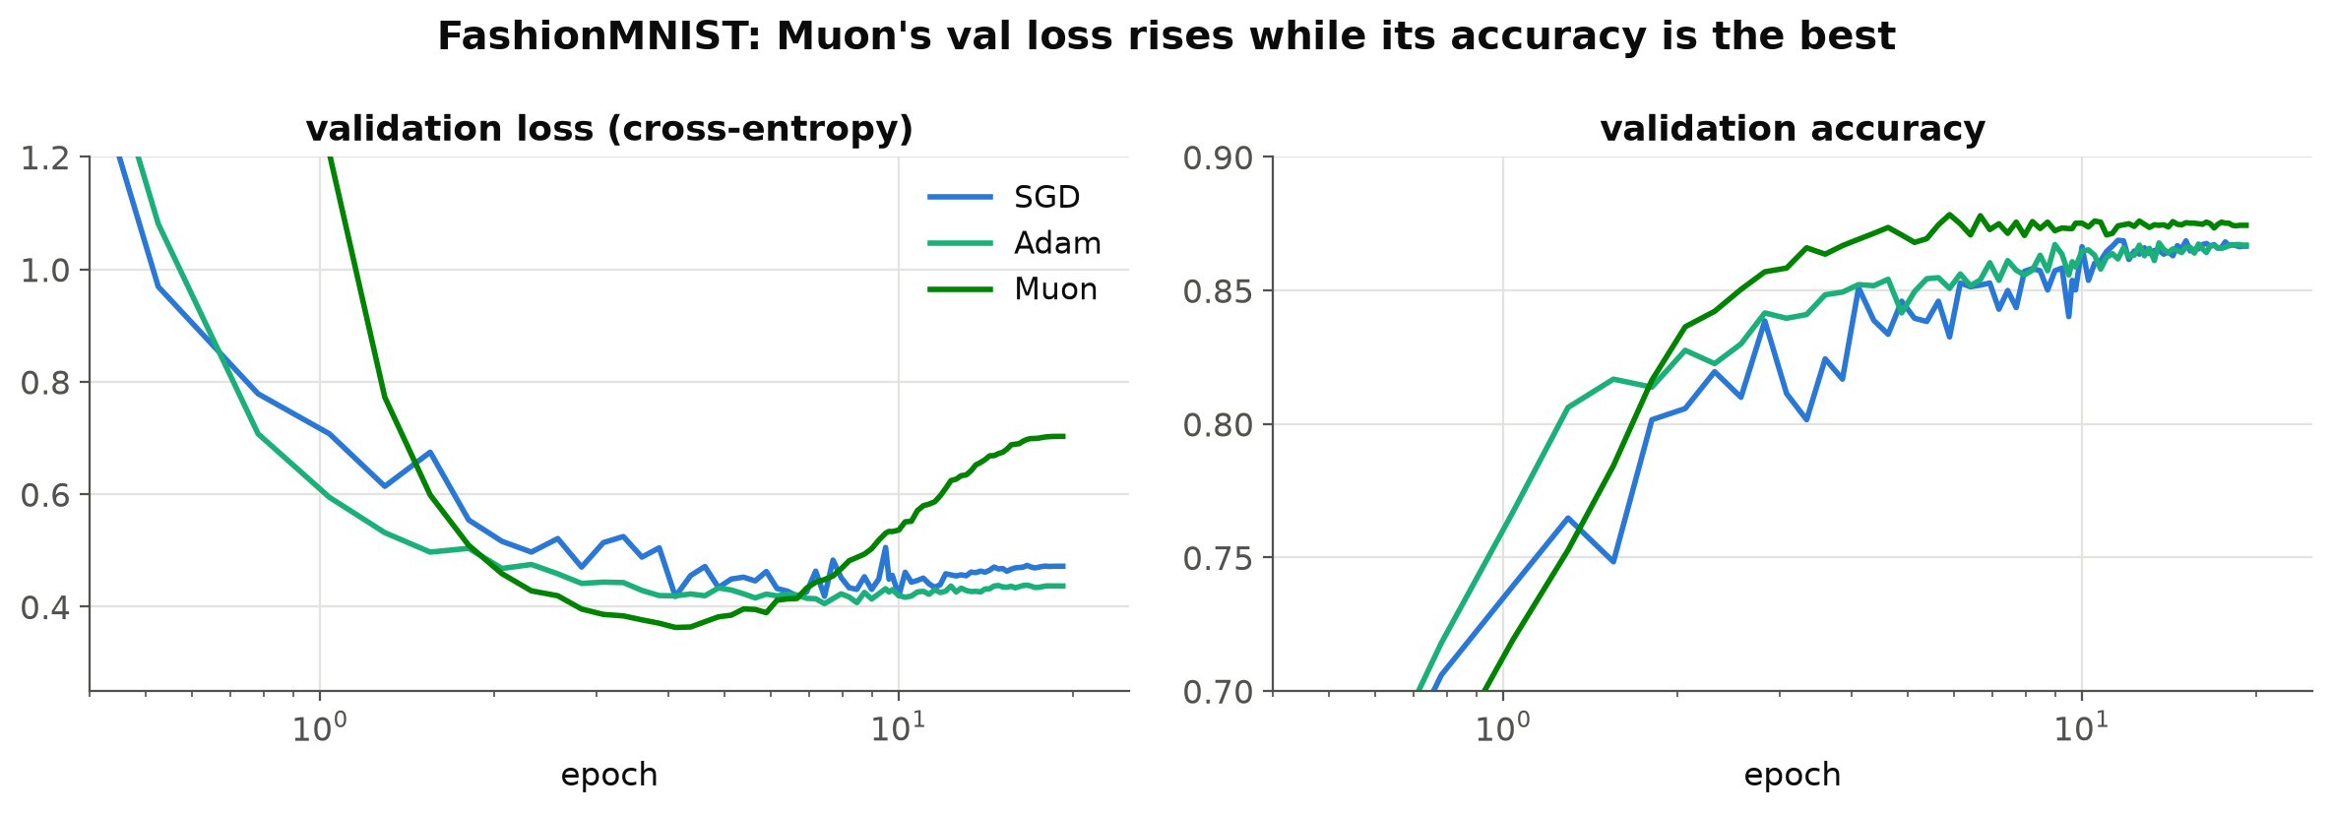
Loss and accuracy can disagree: plot both
Muon memorizes the training set (train loss 3e-5). On the validation images it gets wrong it becomes very confident, so cross-entropy rises, yet it classifies more of them correctly than SGD or Adam.
Notes:
~1.5 min. FashionMNIST. If you only looked at validation loss you'd say Muon is overfitting badly; if you only looked at accuracy you'd say it's the best. Both are true. Ask for both.

Slide 27
Notebook 03: train one run, read it live
1
Change opt and lr in the live cell
Try adam at 1e-1, sgd at 1e-3, muon at 0.1.
live = train(RunConfig(
task="esol", opt="adam",
lr=1e-1, steps=2000))
plots.plot_dashboard(
[best_esol["sgd"], live,
best_esol["muon"]])
2
Run it
The run is drawn into the dashboard next to the cached best SGD and Muon runs.
3
Name the signature
Too low, good, or dead? Which panel told you?
notebooks/03_dashboard.ipynb · §6 “Live” · runs on CPU in ~5 s (Muon ~40 s)
Notes:
~4 min. Switch to the notebook (Colab or local). Run the live cell with a deliberately bad LR first (adam 1e-1: the dead network), ask the room which panel gives it away, then a good one. If time is short, skip — the cached figures on the previous slides carry the point.

Slide 28
How should you choose?
4
Defaults, exceptions, and the figures that tell you which case you're in.
1
The gradient
2
The update
3
The solution
4
Choosing
Notes:
~0.5 min. Part 4: the practical card.

Slide 29






A decision card
Default
Tiny data, smooth loss
Fine-tuning
AdamW + warmup + cosine or WSD decay. Sweep the LR in half-decades (1e-4 … 1e-2) and plot the sweep.
Try full-batch L-BFGS, possibly after an Adam warm start: property regression, potentials, PINNs.
Lower LR, little or no weight decay toward zero. Watch distance from init.
Spikes or NaN
Flat at the baseline
Transformer-scale, compute-bound
Lower the LR, lengthen warmup, clip gradients at 1.0, set Adam β₂ = 0.95.
Dead network: lower the LR. Training longer won't help.
Muon on hidden matrices + AdamW for the rest, or SOAP / Shampoo.
Changed the batch size, width or optimizer? Re-sweep the learning rate.
Notes:
~3 min. The take-home card. Default first; then the four situations that override it. The bottom line is the most violated rule in practice: an LR tuned for one setup does not transfer.

Slide 30
Ask for figures, then read them yourself
A prompt that works
“Sweep the learning rate (half-decades, 2 seeds) for AdamW, SGD + momentum and Muon. Make the sweep plot and the six-panel dashboard at each optimizer's best LR. Then tell me, citing panels, whether any run shows a dead network, divergence, a too-low LR, or a layer that isn't learning.”
Thanks! Questions?
In the repo
playground/ · notebooks 01–03 · optlab/ (logging + plots) · AGENTS.md · TALK_NOTES.md
Notes:
~1 min + questions. The one habit to leave with: don't accept a number from your agent; ask for these figures and look at them. Everything is in the repo — the playground runs in any browser, the notebooks run on Colab CPU.

Slide 31
References
Polyak 1964 (heavy-ball momentum); Nesterov 1983
Duchi, Hazan & Singer 2011 (Adagrad); Tieleman & Hinton 2012 (RMSProp)
Kingma & Ba 2015 (Adam); Loshchilov & Hutter 2019 (AdamW)
Bernstein et al. 2018 (signSGD); Balles & Hennig 2018 (Dissecting Adam)
Kunstner et al. 2023 (sign descent and the SGD–Adam gap on transformers)
Orvieto & Gower 2025, In Search of Adam's Secret Sauce
Bernstein & Newhouse 2024, Old Optimizer, New Norm: An Anthology
Yang, Simon & Bernstein 2023, A Spectral Condition for Feature Learning
Gupta, Koren & Singer 2018 (Shampoo); Vyas et al. 2024 (SOAP)
Jordan et al. 2024 (Muon); Liu et al. 2025 (Muon is Scalable for LLM Training)
Wen et al. 2024, Understanding Warmup-Stable-Decay Learning Rates: A River Valley Loss Landscape Perspective
Saxe, McClelland & Ganguli 2014 (deep linear networks)
Wilson et al. 2017 (adaptive methods and generalization); Gunasekar et al. 2018 (implicit bias and geometry)
Cohen et al. 2021 (edge of stability)
Painted-weights demo after Jeremy Bernstein; re-implemented here
Data: ESOL (Delaney 2004) via MoleculeNet (Wu et al. 2018); FashionMNIST (Xiao et al. 2017)
Notes:
Reference slide; leave up during questions if useful.

